Slide 1
Data Visualization and Dashboards with Tableau
Sarabjit Matharu
Lighthouse Labs

Slide 2
I have used Option 1: Standard Final Project
Canadian Open Data portal. The files used are:
Weekly earnings from 1.1.2001 to 15.4.2015 (weekly_earnings - CSV)
Housing constructions from 1955 to 2019 (real_estate_numbers - CSV)
House prices from 1.1.2005 to 1.9.2020
(real_estate_prices - EXCEL)
Housing_price_index from November 1979 to September 2020
Office_realestate_index from November 1979 to September 2020
Consumer index from November 1979 to September 2020

Slide 3
Show the trend of house prices across Canada in the last 40 years (table housing_price_index).
We have different parameters to see house price trend over the past years.
We can look at avg house only.
Average land only
And also avg house & land
House prices are incresing gradually for most part.

Slide 4
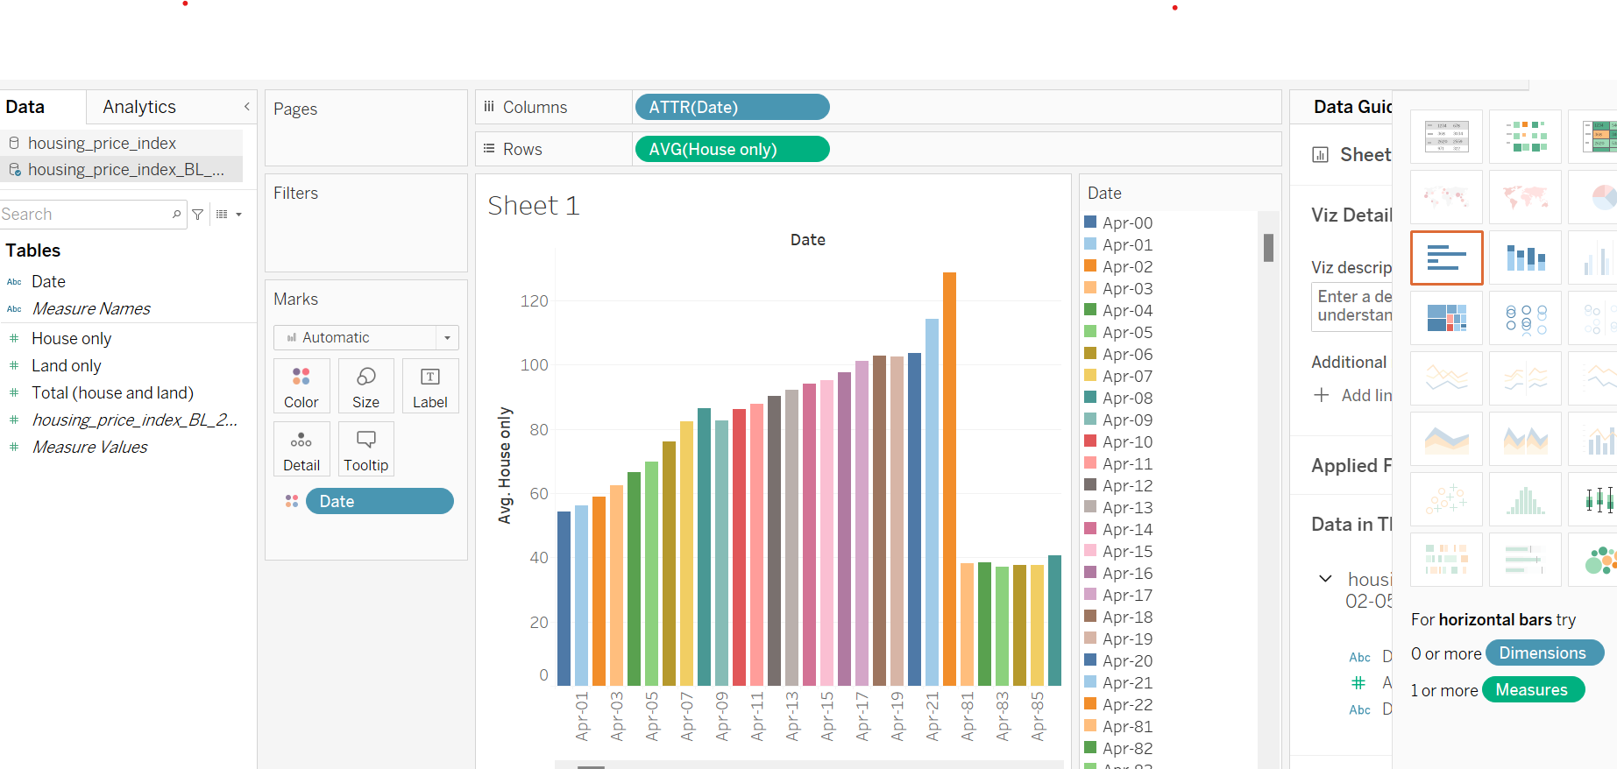
Show the trend of house prices across Canada in the last 40 years (table housing_price_index).

Slide 5
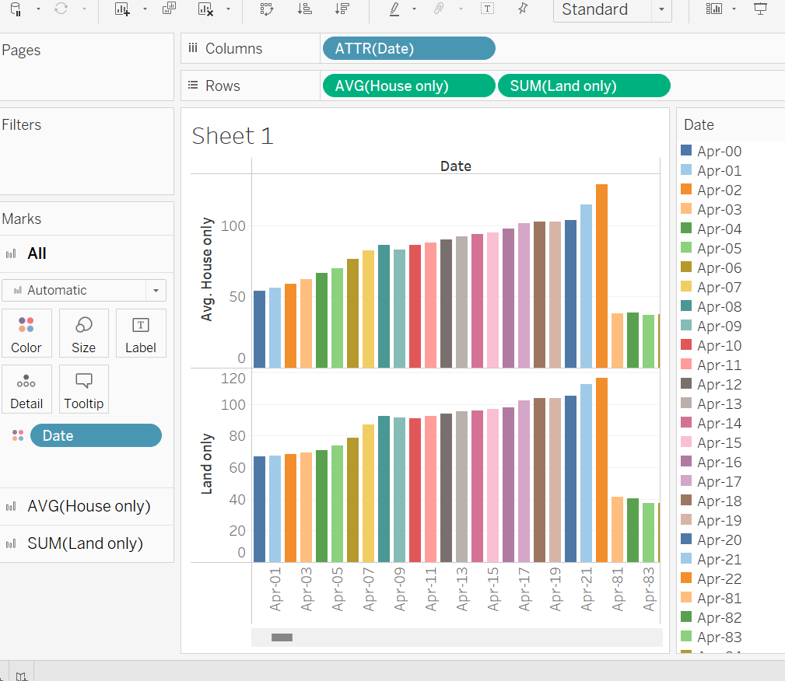
Show the trend of house prices across Canada in the last 40 years (table housing_price_index).

Slide 6
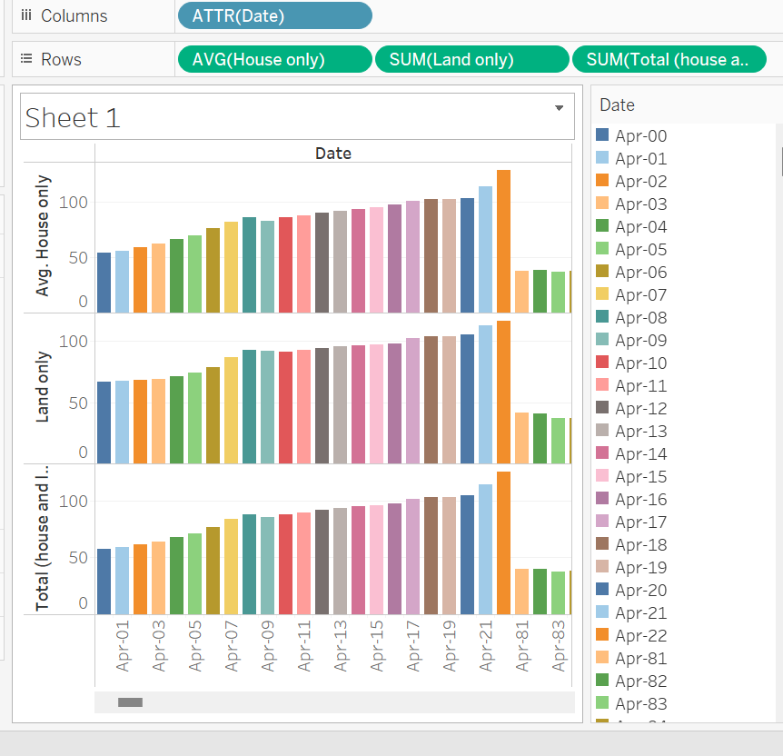

Slide 7
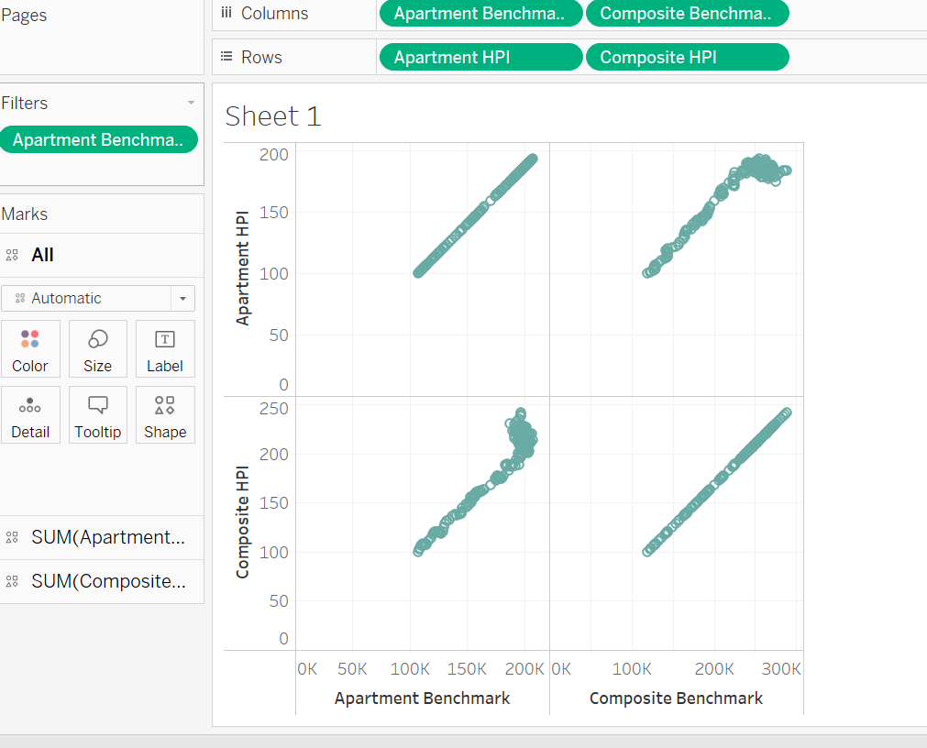
Compare the trend after 2005 with actual benchmark prices in table real_estate_prices to see if there are any differences.

Slide 8
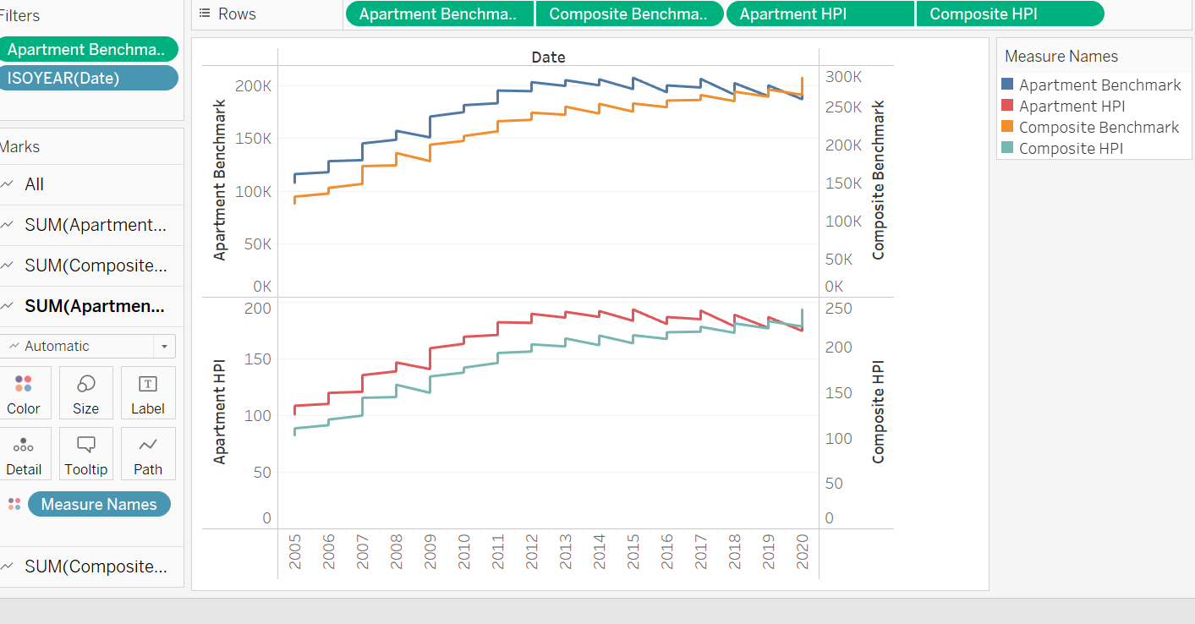
A comparison is done between actual & benchmark values

Slide 9
Compare this trend with the trend of office prices. Which one is getting more expensive, faster?
We have different categories of data eg. Appartment, office, schools, office warehouse etc.
A graph is drawn to see prices between all available types first.
Then a comparison is done to see house & office price tend to see which one is getting more expensive.

Slide 10
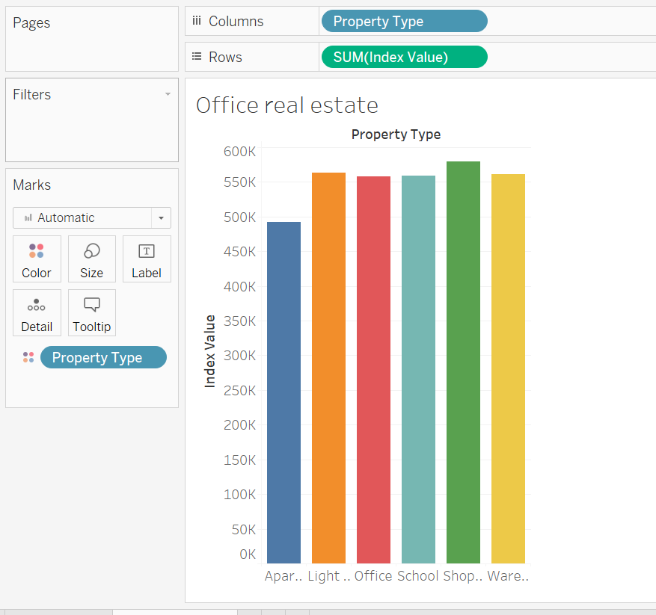
Compare this trend with the trend of office prices. Which one is getting more expensive, faster?

Slide 11
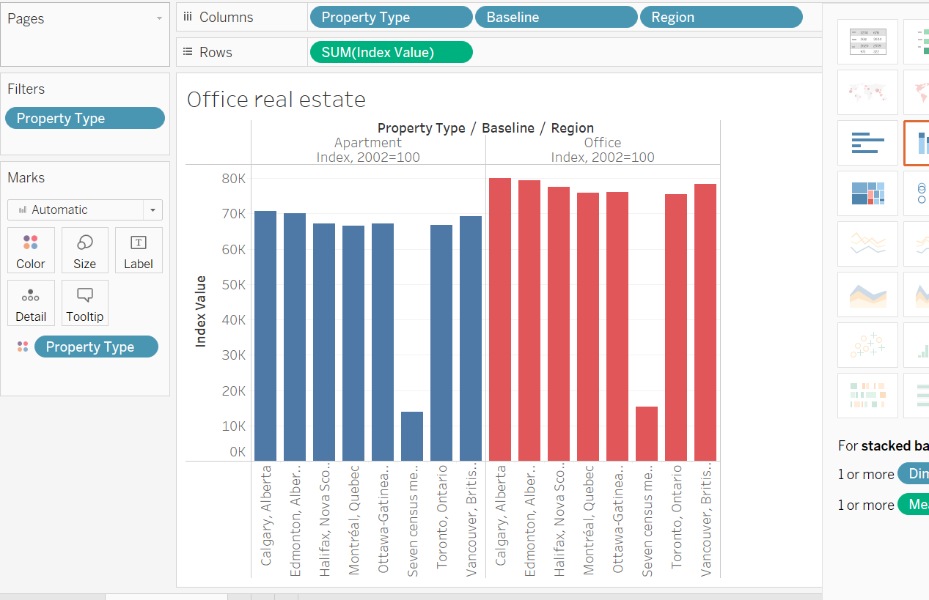
A comparison is done between residential & office real estate and it was found out that prices for offices are getting expensive faster.

Slide 12
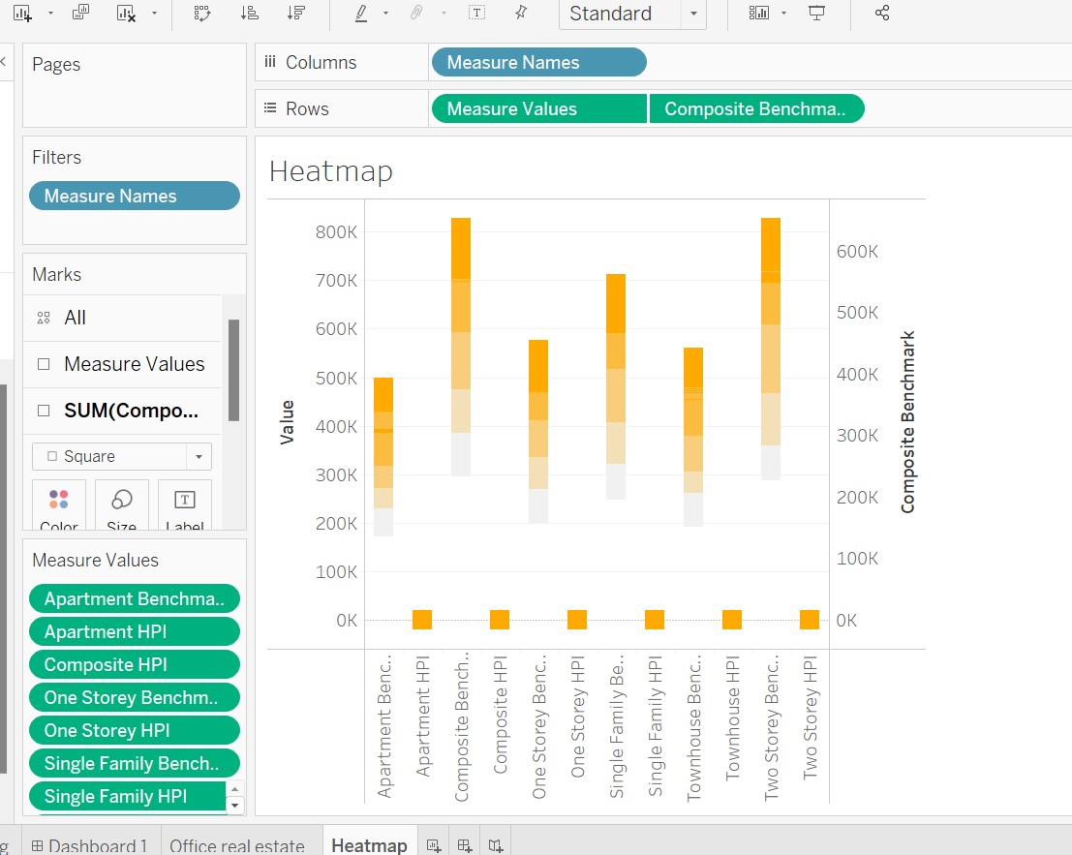
Create a heatmap of Canada with current house prices for each available district.

Slide 13
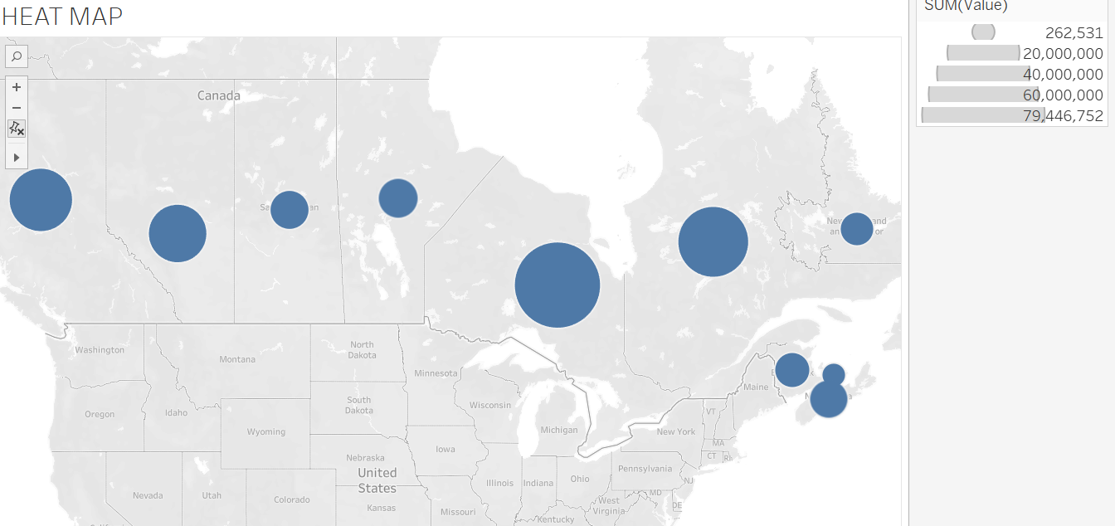
Heat Map with house prices

Slide 14
Are the price differences between different districts increasing?
In the next slide a comparison is done to show price difference between different districts.
From graph on next slide you can some most expensive provinces in Canada are Ontario, Quebec, British Columbia, Alberta.
And some of the least expensive ones are New Foundland, PEI.

Slide 15
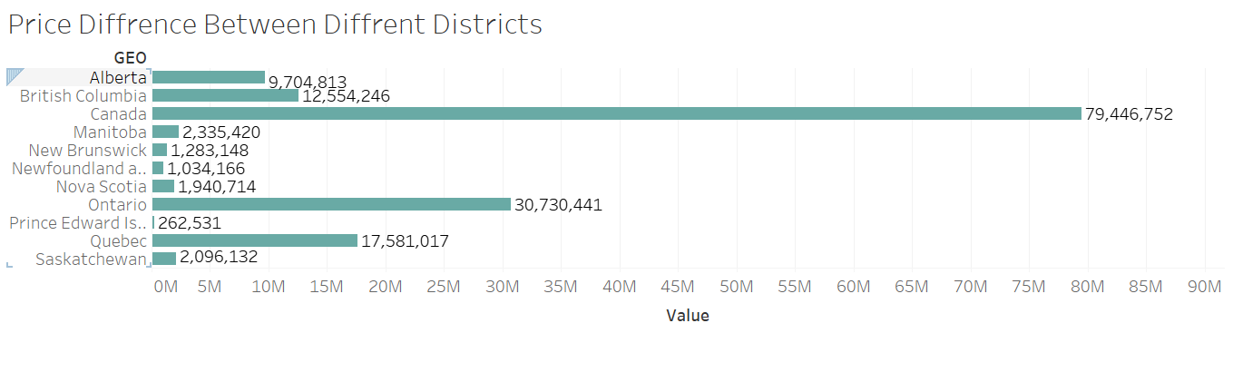
Are the price differences between different districts increasing?

Slide 16
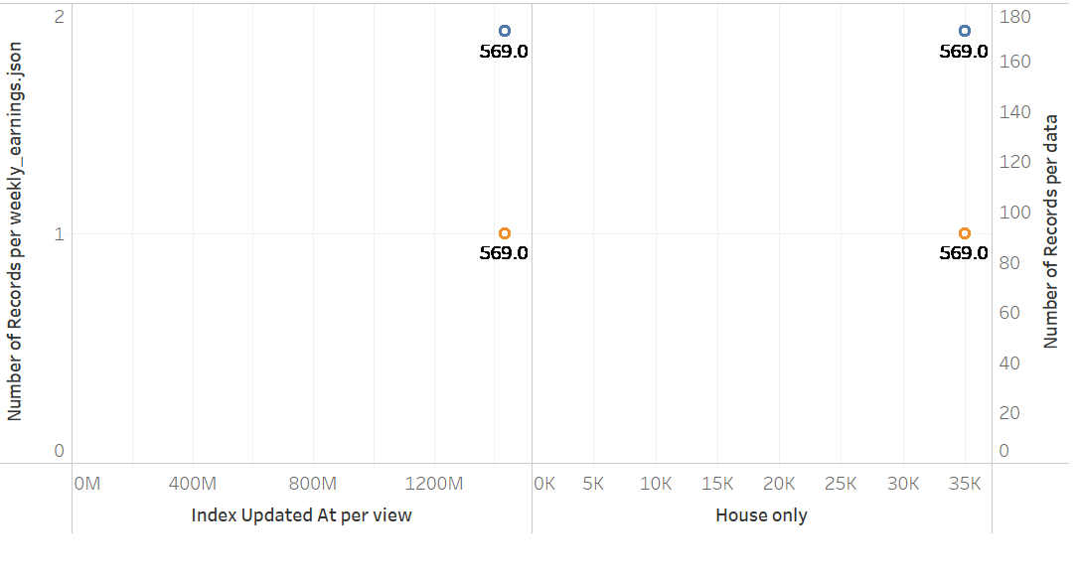
Compare the trend of house prices with earnings. *In case you want to plot monthly salary, be aware that the earnings value is per week.

Slide 17
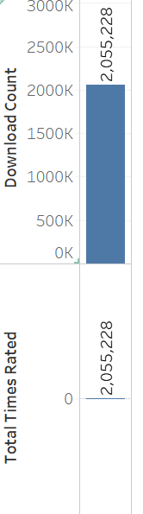
Spendings

Slide 18
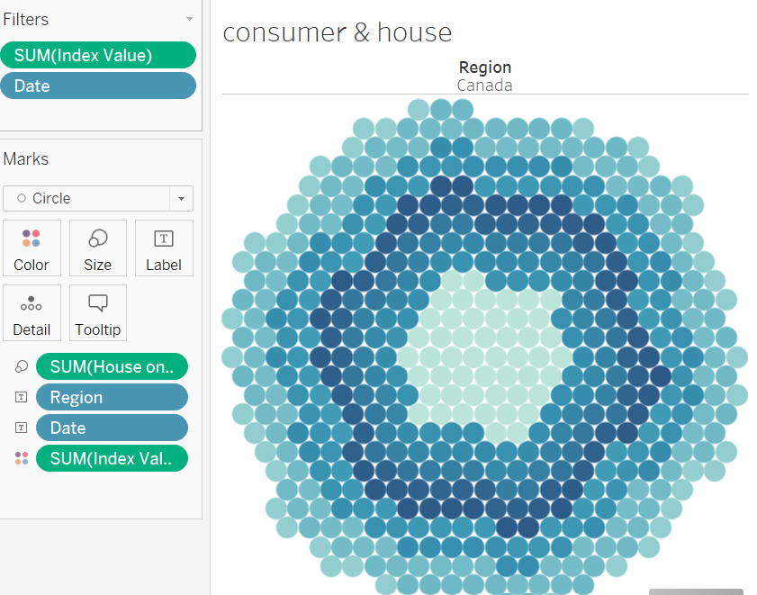
Plot consumer_index together with housing_price_index and fit the regression line between them. Can we predict consumer_index from the housing_price_index?

Slide 19
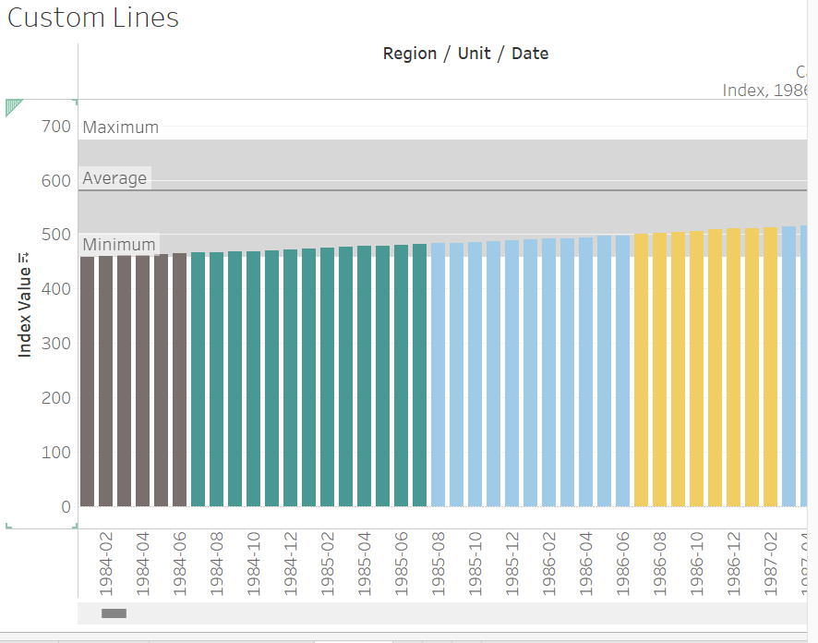

Slide 20
Findings of Project
Some redundant data is available.
Overtime in Canada house prices are incensing.
Income is not increasing at the speed house prices are.
Office prices are getting more expensive faster as compared to residential units.
Specially in last few years real estate has gone up so high that affording a house is getting out of the reach.
I Will explore more areas of data if I had more time.

Slide 21
THANK YOU

